Slide 1
Presentation on the topic. Banks of Transnistria and the USA, their uniqueness.
What banks are there in Transnistria?

Slide 2
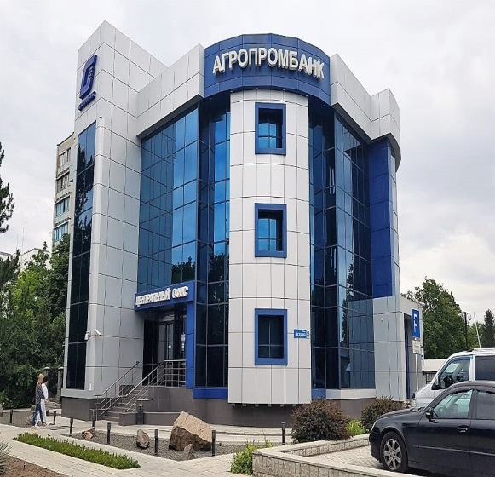
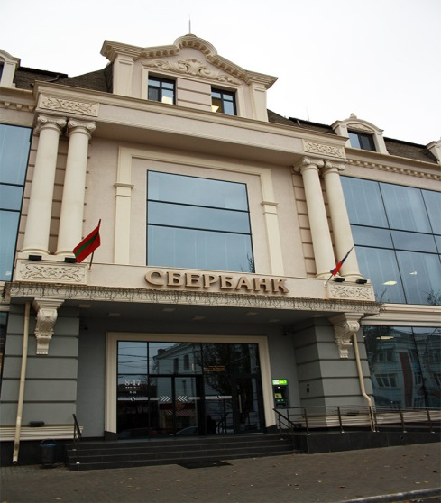

The following banks are located in Transnistria. Such as: Agroprombank, Sberbank, Eximbank

Slide 3
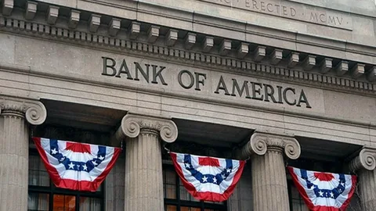


And if we consider the USA Banks, then there are also a certain number of them. Here we can see certain banks:

Slide 4

I think it would not be superfluous to tell you about the Banking system in Transnistria and the United States. And I think we should first tell you about the Banking system of Transnistria. To understand how it works, and later to affect the monetary system. In any case, I will tell you about the Banking system as a whole, and then I will touch on statistics. The banking system is a set of different types of national banks and credit institutions operating within the framework of a common monetary mechanism. The banking system includes a central bank, a network of commercial banks and other credit and settlement centers. The central bank conducts state emission and currency policy, being the core of the reserve system. Commercial banks carry out all other types of banking operations.
As an example, the banking system of Transnistria can be cited.
With regard to the Banking System in Transnistria:
The banking system of Transnistria as an independent state began to take shape at the end of 1992. It consists of two levels: the Pridnestrovian Republican Bank and commercial banks.
The Republican Bank regulates capital adequacy and risk, sets minimum capital requirements for all commercial banks registered in the country. Transnistria is one of those republics that was able to create its own monetary system and for 20 years it has continued to remain as we know it at the moment.
The currency of Transnistria:
Transnistria has its own currency, as in many other countries. However, little is known about her. But in comparison with others, it is much cheaper in value than completely different currencies.

Slide 5
With regard to the USA banking system:
The U.S. banking system has been shaped for centuries. The legal regulation of banking in the country is based on the principles laid down in the Constitution of the United States of America and in the Declaration of Independence. The activities of credit institutions are largely regulated by the laws of the late XIX — early XX century. As a result of the crisis of 1907, the Federal Reserve System appeared, and the result of the Great Depression was a ban on securities transactions and mandatory deposit insurance.
The US monetary system:
In the USA, when it began its origin, it did not initially have its own currency. However, over time, it appeared. The very first currency in the United States appeared in the middle of the 17th century. And it was called oak and pine sheeling. After that, in 1990, the first paper money appeared, which was tied to a gold coin. And also, until the middle of the 17th century, North America did not have its own monetary system.
In 1791, the first bank in the United States appeared, which issued the national currency for two decades.

Slide 6
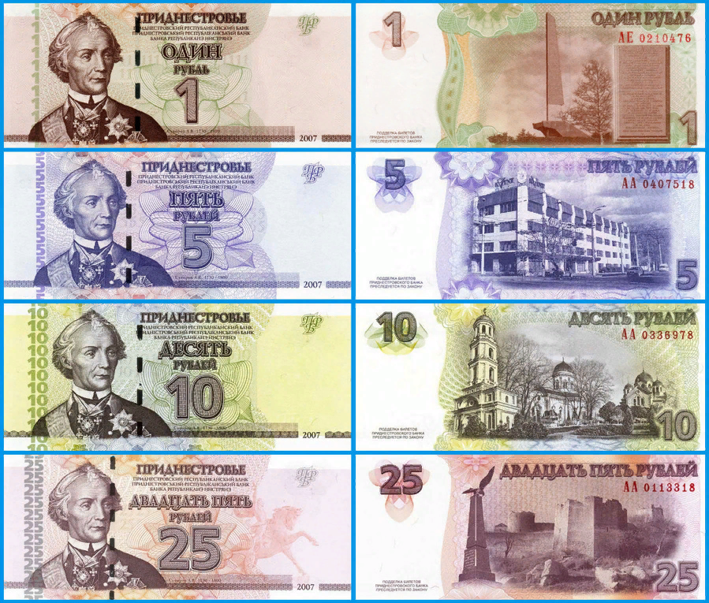
What is the currency of Transnistria?
The currency of Transnistria ranges from 1 to 500 rubles in banknotes and from 5 to 50 kopecks. Each of the bills depicts a figure. In the early years of the declaration of independence, the PMR did not have its own money. Soviet-style paper money was used here as legal tender, as well as banknotes issued by the Bank of Russia in 1992. Stamps with a portrait of Alexander Suvorov were pasted on them – the monetary and vintage denominations coincided. However, after a long time, we know the currency of Transnistria as it is now.

Slide 7
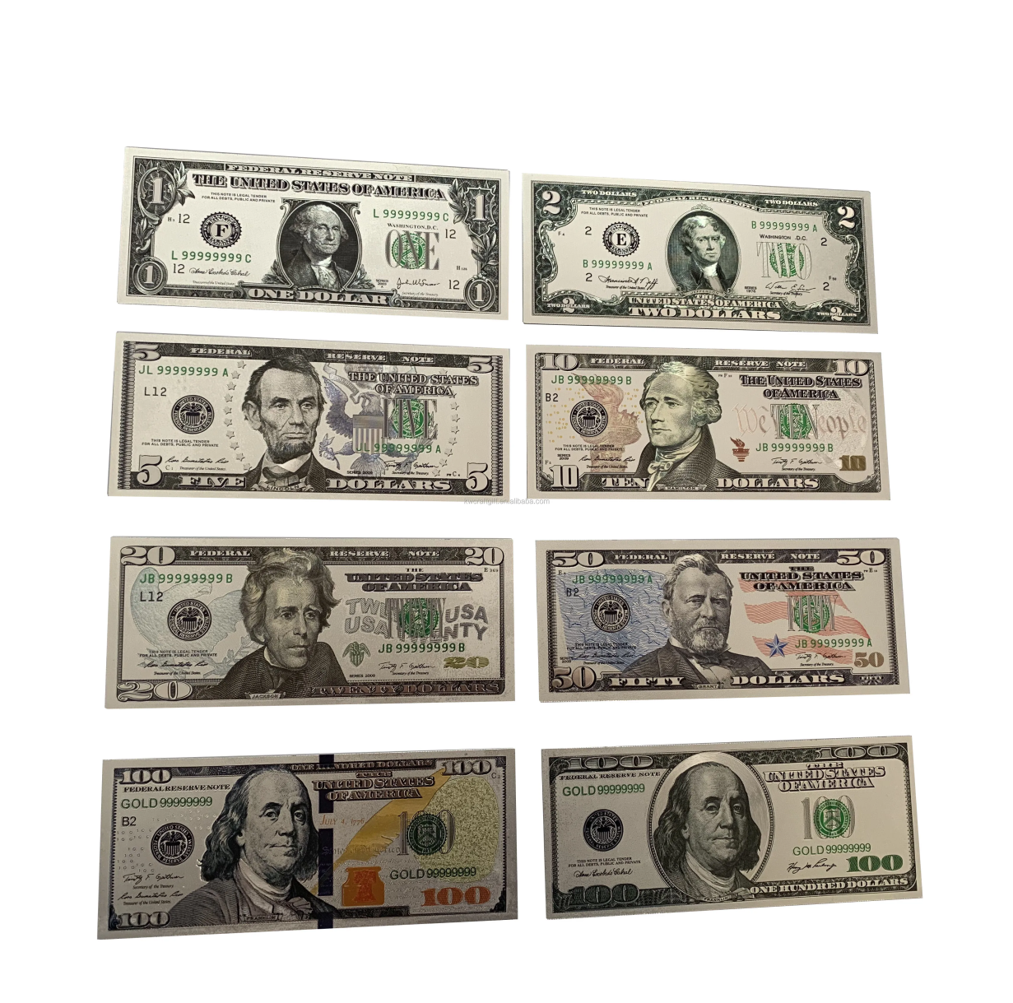
What is the currency of USA?
In the USA, there is a currency from 1 to 100 dollars, and each of these currencies depicts certain personalities. It is worth noting that one of these bills depicts President George Washington. US dollars are the monetary unit of the United States of America, and are not metal-exchangeable Treasury bills in the United States. And it is also, to this day, one of the most used currencies.

Slide 8

Let's compare the banknotes of Transnistria and the USA
US banknotes
Banknotes of Transnistria

Slide 9

Agroprom Bank:
AGROPROMBANK (all-Union joint-stock commercial agro-industrial bank), a universal commercial bank in the USSR. It was established in 1990. He carried out credit and settlement services for all sectors of the national economy, provided leasing, factoring and engineering services, performed foreign exchange transactions and international settlements, issued guarantees, guarantees and other monetary obligations.

Slide 10

Sberbank:
Transnistria Sberbank is a commercial bank, one of the largest banks in Transnistria. Transnistria Sberbank, a universal bank providing a wide range of banking services to corporate and private clients, is the only bank in Pridnestrovie providing a state guarantee for the safety and repayment of 100% of the amount of deposits of citizens.

Slide 11

Eximbank:
Exim Bank is a bank that allows you to use loans from banks on more favorable terms offered by other banks in Transnistria. This bank has been operating for a long time, and it has been in this market for decades. At the moment, this bank in Transnistria is considered one of the dynamically developing banks in Transnistria.

Slide 12

The Bank of America:
Bank of America, in full Bank of America Corporation, one of the largest banking and financial services brands and corporations in the United States. It was formed through NationsBank’s acquisition of BankAmerica in 1998. Bank of America is headquartered in Charlotte, North Carolina. The bank’s history dates to 1904 when Amadeo Peter Giannini opened the Bank of Italy in San Francisco.

Slide 13

The Merrill Lynch:
Merrill (officially Merrill Lynch, Pierce, Fenner & Smith Incorporated), previously branded Merrill Lynch, is an American investment management and wealth management division of Bank of America. Along with BofA Securities, the investment banking arm, both firms engage in prime brokerage and broker-dealer activities.

Slide 14

The Wells Fargo:
Wells Fargo & Company is an American multinational financial services company with a significant presence around the world. The company operates in 35 countries and serves more than 70 million customers worldwide. It is a systemically important financial institution, according to the Financial Stability Board, and is considered one of the "Big Four banks" in the United States, along with JPMorgan Chase, Bank of America and Citigroup.

Slide 15
Currencies inherent in PMR banks:
APB: |  |  | Sber: |  |  | Exim:
Rup | Euro | USD | Rup | Euro | USD | Rup | Euro | USD

